Slide 1
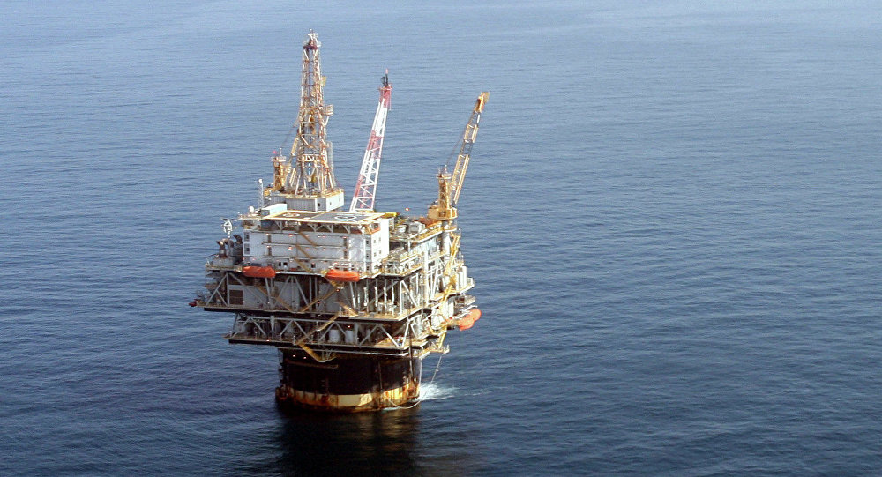
Asset Tracking on Offshore Oil Rig
System Architecture
Approach
Context
During the Deepwater Horizon oil spill disaster, authorities were searching for the lost employees for 3 days.
Market Analysis
Prototype
Scope and Impact
Tracking system on oil rig for employees and assets
Increase safety for oil rig workers

